Slide 1
SmartPlant 3D Electrical Task
Presented by:
xxxxxxxx

Slide 2
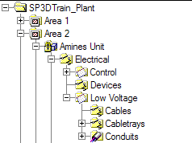
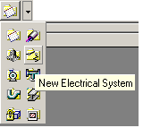
Electrical System
Is a high-level grouping of Cableway Runs and is initially created in the System and Spec Task environment or via the WSE
© 2005. Intergraph Corporation. All Rights Reserved.

Slide 3
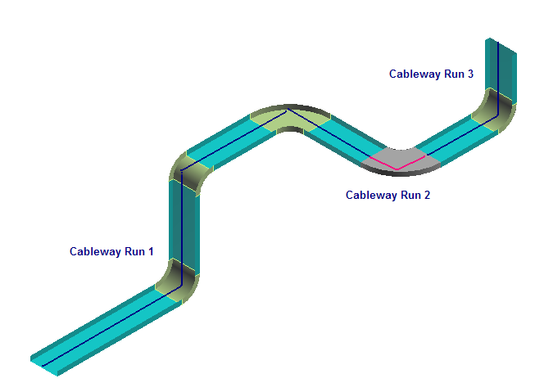
Cableway Run
  A Cableway run identifies one or more path features that share a
  Common Electrical Specification, Fill efficiency, Signal Type, Voltage Grade, etc
  One or more cableway runs make up an Electrical system
© 2005. Intergraph Corporation. All Rights Reserved.

Slide 4
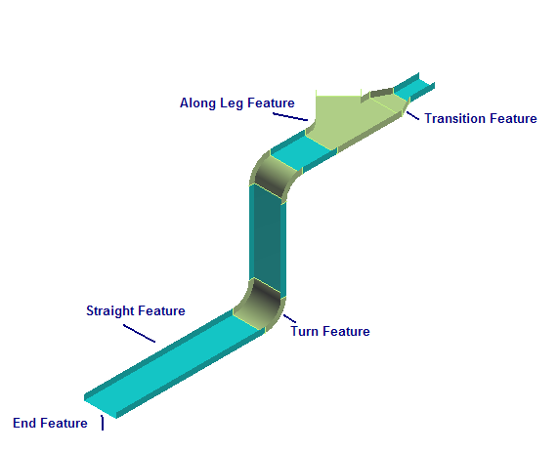
Features
Define the geometry path, cross section of the cableway run and your design intent that occur along the path
When you route a cableway run, you place features
© 2005. Intergraph Corporation. All Rights Reserved.

Slide 5
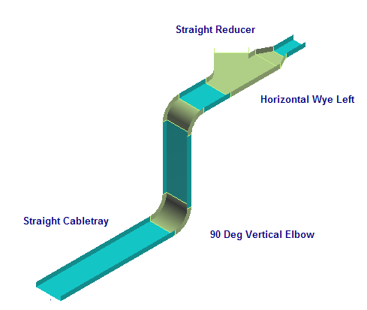
Parts
Parts are the physical components generated by the feature
© 2005. Intergraph Corporation. All Rights Reserved.

Slide 6
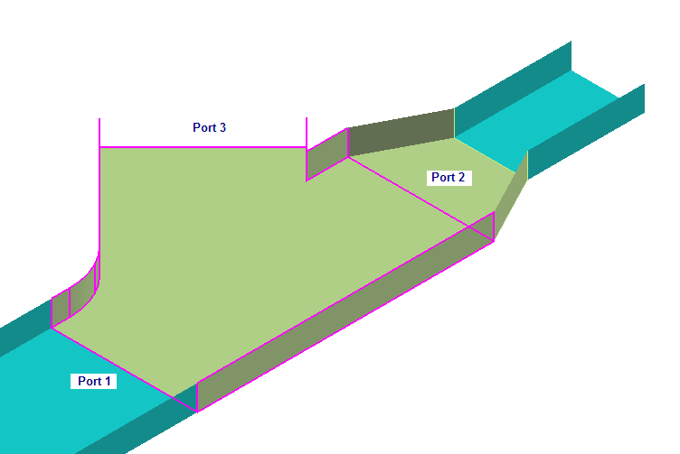
Port
Port is the actual connection point for the part
© 2005. Intergraph Corporation. All Rights Reserved.

Slide 7
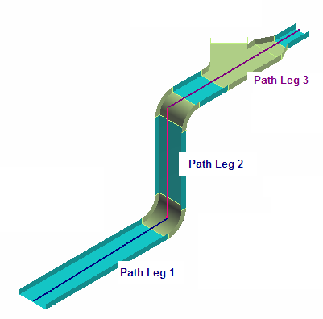
Legs
  is a section of a cableway run maintaining one general direction
  between turns, branches and end
© 2005. Intergraph Corporation. All Rights Reserved.

Slide 8
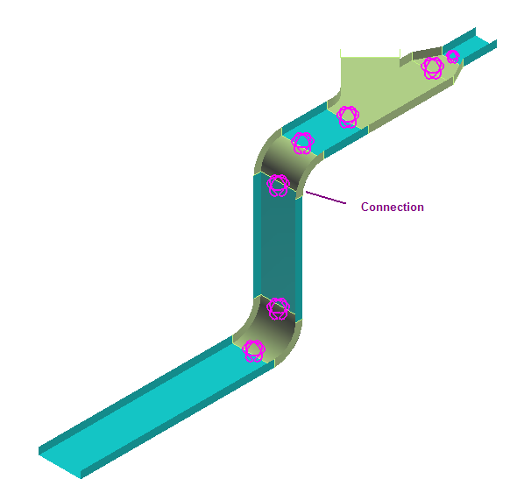
Connections
  Provides the connectivity model between the ports of different
  Electrical Components and Equipment ports
© 2005. Intergraph Corporation. All Rights Reserved.

Slide 9
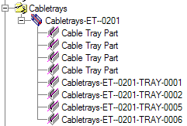
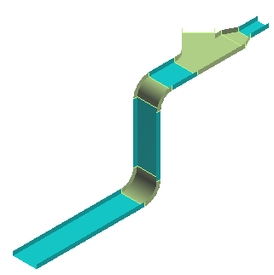
Cabletray Hierarchy
  - Electrical System
  - Cableway Run
  - Features
  - Parts/Components
  - Ports
  - Connections
© 2005. Intergraph Corporation. All Rights Reserved.

Slide 10
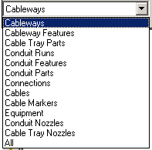
Select Command
Provides specific filters:
Workspace Explorer (set the filter to all and key in the string in the field to find an object)
Tool -> Select by Filter
© 2005. Intergraph Corporation. All Rights Reserved.

Slide 11
Route Cableway Command
Route Cableway Smart Step Ribbon Bar
Properties
Start Route – End Route points
Working Plane
Run name
Shape, Width, Depth and Orientation
Angle Lock – Angle Control
Length Lock – Length
Offset
© 2005. Intergraph Corporation. All Rights Reserved.

Slide 12
Route Cableway Command
  Start Routing a Pipe Run from
    a equipment port
    a component port
    a point in space
    an existing cableway run
Start
© 2005. Intergraph Corporation. All Rights Reserved.

Slide 13
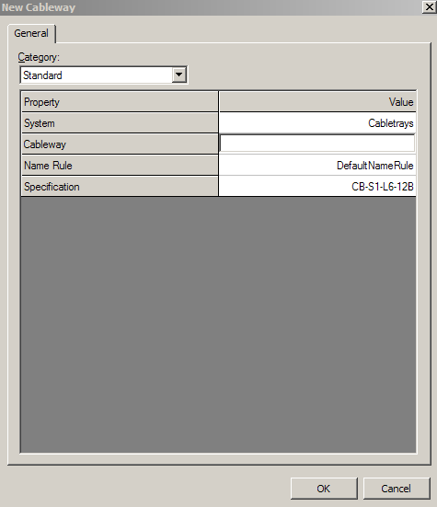
New Cableway Run Dialog Box
Define New Run Properties
Standard Category
  System
  Name Rule
  Specification
Cable Fill Category
  Fill Efficiency
  Signal Type
  Voltage Grade
Other Categories
  Surface treatment
  Responsibility
© 2005. Intergraph Corporation. All Rights Reserved.

Slide 14
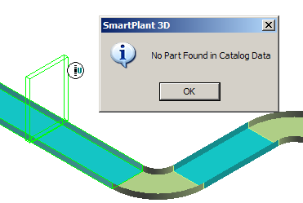
Route Cableway Command
  In case of No Parts Found during routing, the system will display a warning message and commit the change
© 2005. Intergraph Corporation. All Rights Reserved.

Slide 15

Route Cableway Command
  Constrains the route path to a specific plane
    Ctrl + Keyboard
      1 - Plan Plane
      2 - Elevation Plane: East-West
      3 - Section Plane: North-South
      4 - Plane by Turn/Branch
      5 - Plane by Three Points
      6 - No Plane
Route Plane
© 2005. Intergraph Corporation. All Rights Reserved.

Slide 16
Route Cableway Command
  Cross section type: Rectangular (WxD)
  Circular (Diameter)
  Flat Oval (WxD)
Type
sizes
Orientation
© 2005. Intergraph Corporation. All Rights Reserved.

Slide 17
Route Cableway Command
  Enter or select an angle for the current route path
  Angle Lock: Lock or unlock the Angle field
  By Default: Dynamic readout of the current bend angle as defined by the cursor
  The angle field can only be 0 or 90 if the working plane is set to NO Plane.
Angle
© 2005. Intergraph Corporation. All Rights Reserved.

Slide 18
Route Cableway Command
  Enter or select a length for the current route path
  Length Lock: Lock or unlock the length field
  By Default: dynamically displays the current length of the pipe run from a turn point or a starting point
Length
© 2005. Intergraph Corporation. All Rights Reserved.

Slide 19
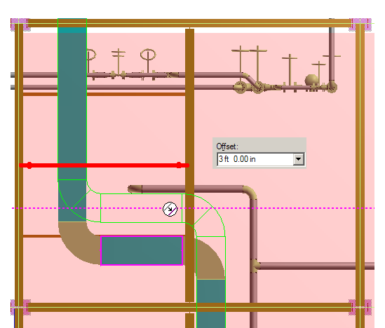
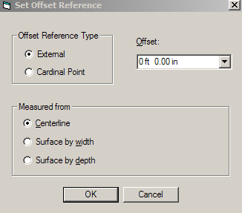
Route Cableway Command
  Offset option is available for turn and straight features
    Centerline
    Surface by Width
    Surface by Depth
© 2005. Intergraph Corporation. All Rights Reserved.

Slide 20
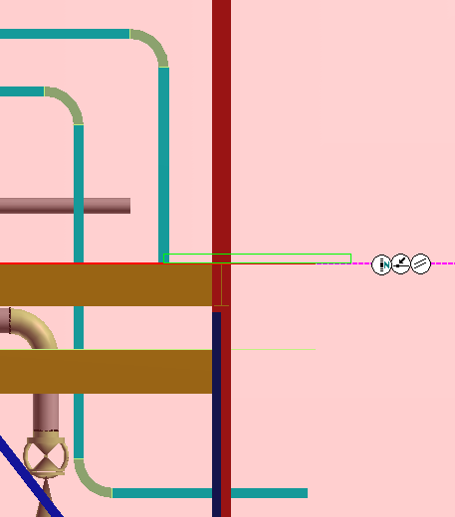
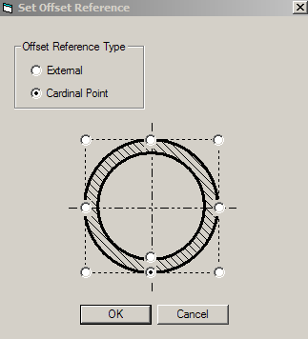
Route Cableway Command
Routing by Cardinal Point
Offset Reference
© 2005. Intergraph Corporation. All Rights Reserved.
Notes:
-

Slide 21
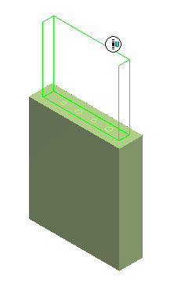
Route Cableway Command
  Route a cableway Run from a port
  When you select a port during the creation of a cableway run, the command automatically uses the Width and Depth of the port as the size of the cableway run
© 2005. Intergraph Corporation. All Rights Reserved.

Slide 22
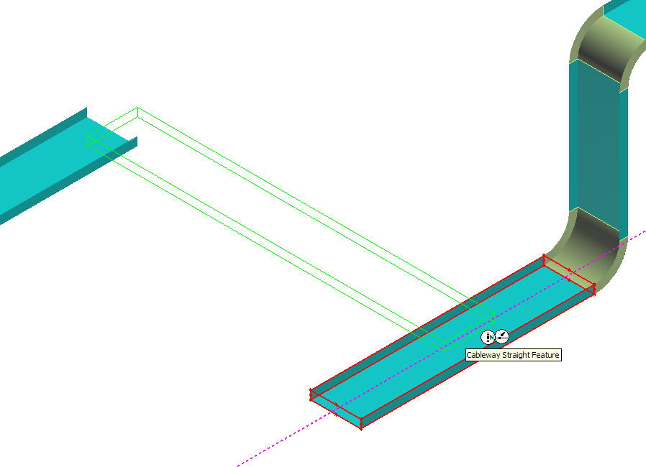
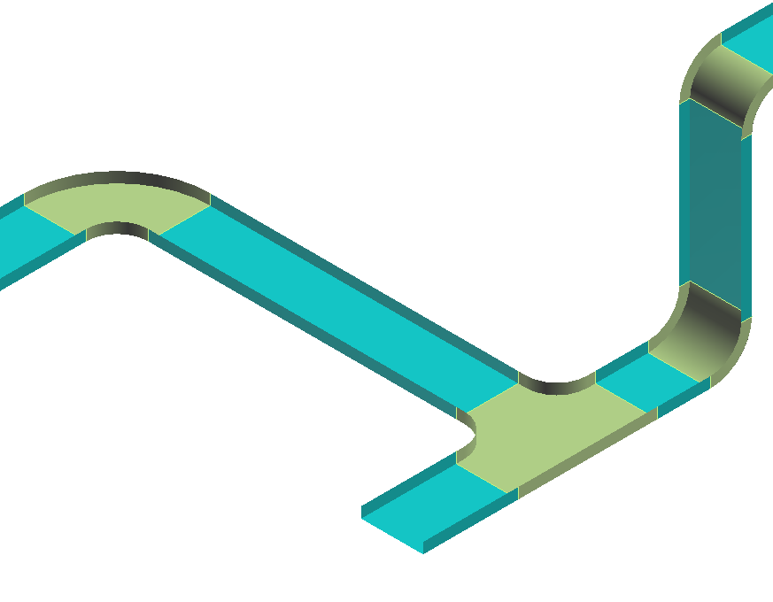
Route Cableway Command
  Route to a Straight Feature
  Intersect to Branch (Use Smartsketch service)
© 2005. Intergraph Corporation. All Rights Reserved.

Slide 23
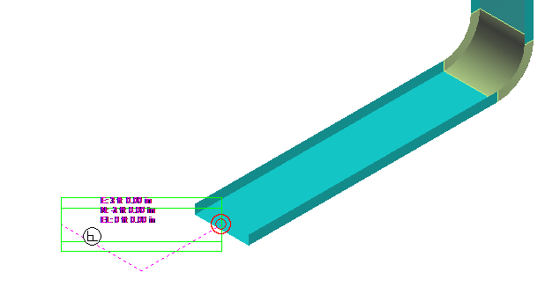
Route Cableway Run with PinPoint
  PinPoint provides coordinate inputs to the route command.
  E, N, El coordinates are relative to Target Point.
  dynamically displays the coordinate/distance values.
  Lock the coordinate/distance values.
© 2005. Intergraph Corporation. All Rights Reserved.

Slide 24
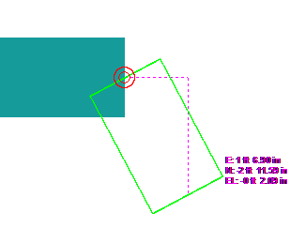
Route Cableway Run with PinPoint
  Example:
  Use the PinPoint tool to constructs a new end point of the cableway run using the E, N and EL locking fields (function keys F6, F7 & F8).
© 2005. Intergraph Corporation. All Rights Reserved.

Slide 25
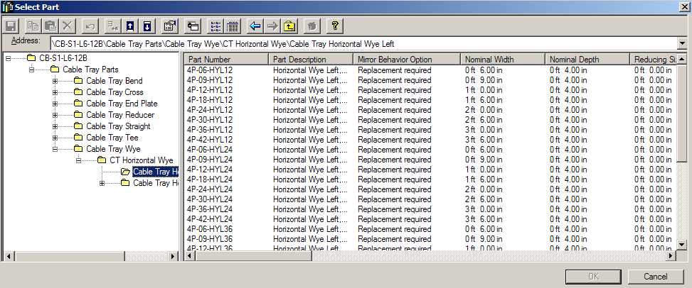
Insert Component Command
© 2005. Intergraph Corporation. All Rights Reserved.

Slide 26

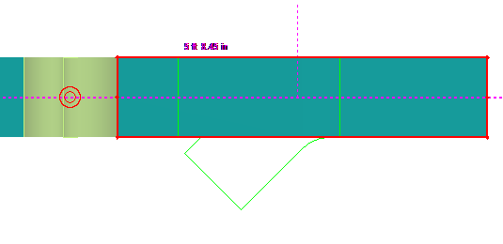
Placing Components using Point Along
  You can use the Point Along command to help you insert components at specific locations along a cableway run
  Point Along ribbon bar
Point Along
Direction to measure
Distance from Reference point
Reference
Element
Reference Point
© 2005. Intergraph Corporation. All Rights Reserved.

Slide 27
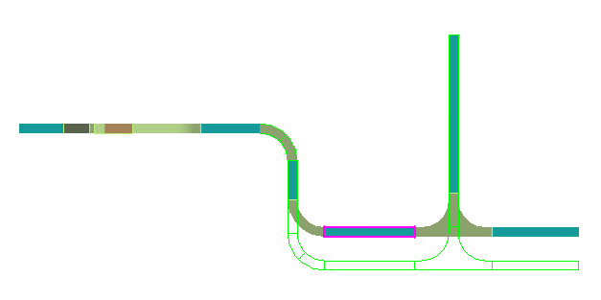
Edit Straight Features
  Moving a SF moves the entire leg to which the feature is connected.
  The move direction is always perpendicular to the axis of the SF.
  A branch feature (BF) connected to the moved leg maintains its original angle.
  Movement stops when parts on the associated leg overlap, or when they overlap with adjacent parts on connected legs.
© 2005. Intergraph Corporation. All Rights Reserved.

Slide 28

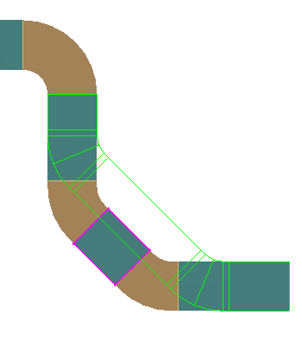
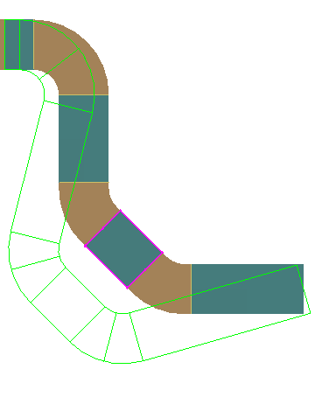
Edit Straight Features
  When the leg length is not locked on the move, the ends of the associated legs in the plane of motion are extended or shortened along the adjacent legs that do not move. Their ends are extended or shortened to connect with the new position of the moved leg
  When the length of the leg is fixed on the move, then the turn points are modified and the adjacent straight features modify both length and angle to remain connected to the new turn points
© 2005. Intergraph Corporation. All Rights Reserved.

Slide 29
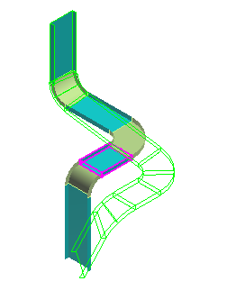
Edit Straight Features
  The end of the associated leg that is connected to an adjacent leg that is not in the plane of movement moves along the motion vector. The end of the adjacent leg is modified to connect to the new position of the moved leg.
  When equipment moves, the leg moves with the equipment nozzle to remain collinear with the nozzle as much as possible.
© 2005. Intergraph Corporation. All Rights Reserved.

Slide 30
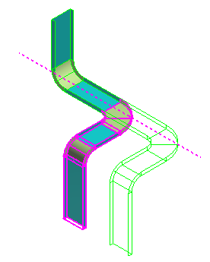
Edit Straight Features
  Shift – Select Command
© 2005. Intergraph Corporation. All Rights Reserved.

Slide 31

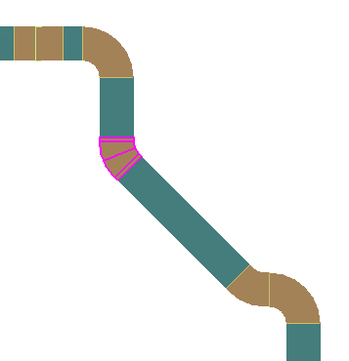
Edit Turn Features
  Angle 1 - Specifies the angle of the turn that you are editing. Angle 2, 3 - Specifies the angle of the turn feature located at the end of one associated leg. If this box is blank, there is no turn feature located at the end of the leg. You can lock this angle by clicking.
Angle 3
Angle 1
Angle 2
© 2005. Intergraph Corporation. All Rights Reserved.

Slide 32
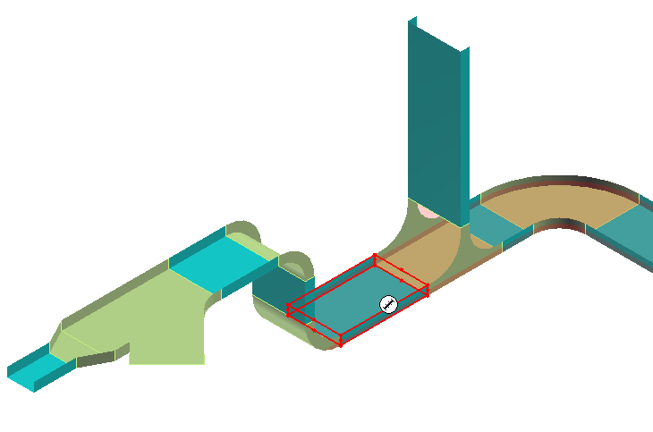
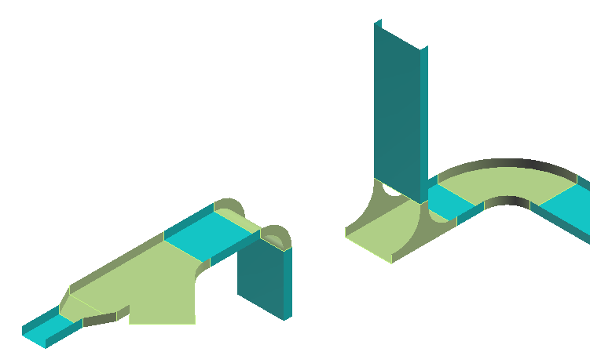
Delete Command
Deleting a straight feature removes connected turn features
© 2005. Intergraph Corporation. All Rights Reserved.

Slide 33
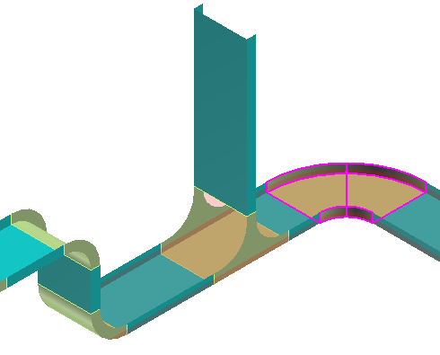
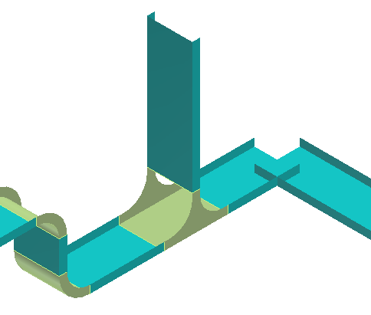
Delete command
  Delete a Turn Feature
  Straight features connected to the deleted turn do extend to the turn point, and end features are added to open ends
© 2005. Intergraph Corporation. All Rights Reserved.

Slide 34
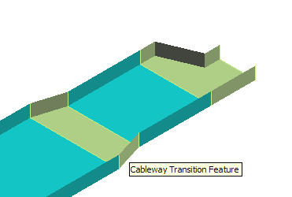
Insert Transition Features
Change size
Setting
Length
Shapes
Orientation
Alignment
Display available component
From
and To
© 2005. Intergraph Corporation. All Rights Reserved.

Slide 35
Edit Transition Features
Change size
Length
End choices
Shapes
Setting
From
and To
Orientation
Alignment
Display available component
© 2005. Intergraph Corporation. All Rights Reserved.

Slide 36
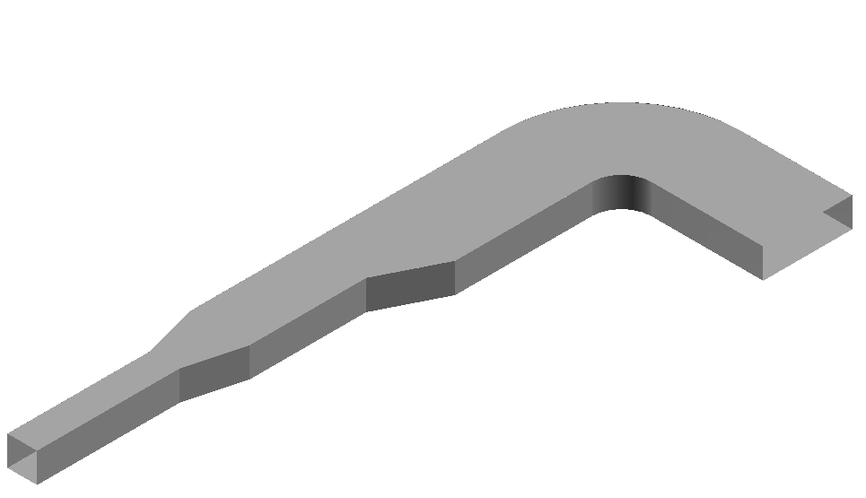
Cableway (No Parts)
  Represents a routed space
© 2005. Intergraph Corporation. All Rights Reserved.

Slide 37
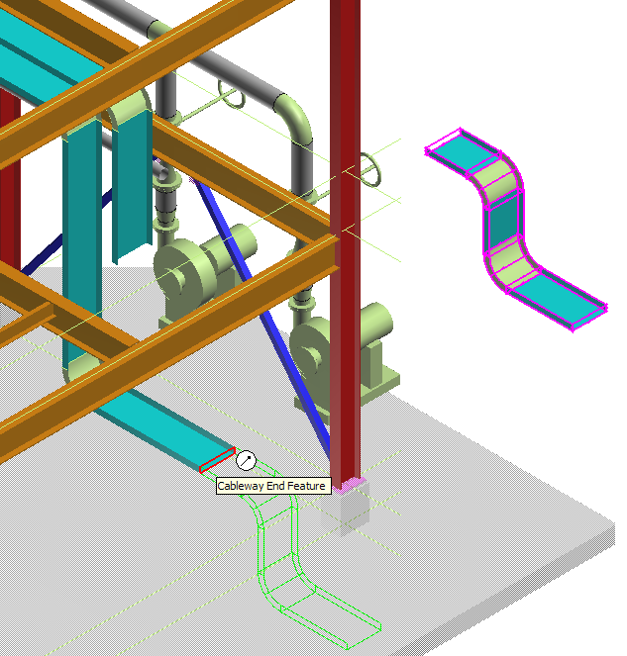
Modification
  Copy/Paste commands is available
  Mirror Copy command is available
  Creation of a connection (geometry permitting) when multiple objects are moved and placed on another object
© 2005. Intergraph Corporation. All Rights Reserved.

Slide 38
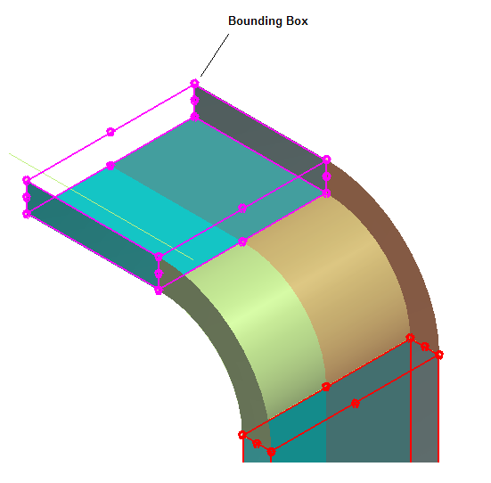
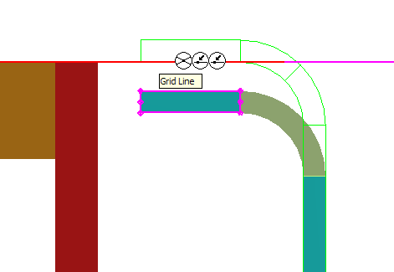
Modification
  Feature Bounding Box
© 2005. Intergraph Corporation. All Rights Reserved.

Slide 39
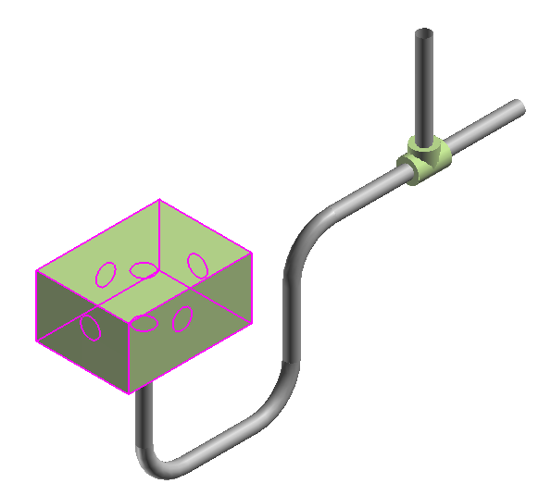
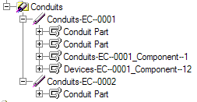
Conduit Hierarchy
  - Conduit System
  - Conduit Run
  - Features
  - Parts/Components
  - Ports
  - Connections
© 2005. Intergraph Corporation. All Rights Reserved.

Slide 40
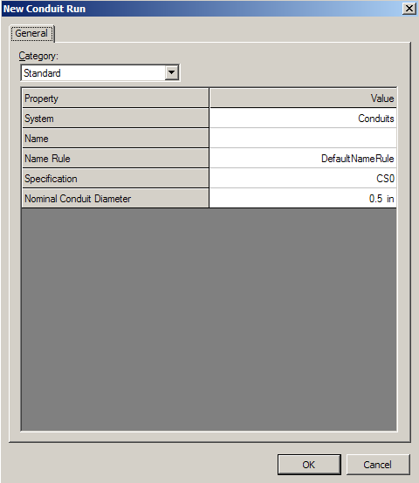
Conduit Run Dialog Box
Define New Run Properties
Standard Category
  System
  Name Rule
  Specification
  Nominal Conduit Diameter
Cable Fill Category
  Fill Efficiency
  Signal Type
  Voltage Grade
Other Categories
  Surface treatment
  Responsibility
© 2005. Intergraph Corporation. All Rights Reserved.

Slide 41
Route Conduit Command
Route Conduit Smart Step Ribbon Bar
Properties
Start Route – End Route points
Working Plane
Run name
Angle Lock – Angle Control
Length Lock – Length
Offset
© 2005. Intergraph Corporation. All Rights Reserved.

Slide 42
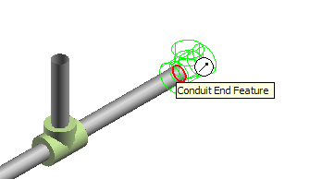
Insert Component Command
© 2005. Intergraph Corporation. All Rights Reserved.

Slide 43
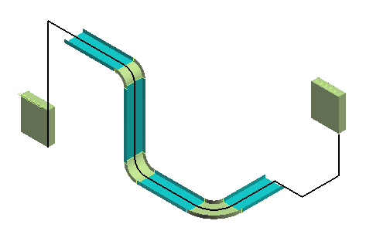
Insert Cables
  The Insert Cable command is used to create a cable in the SP3D database as a member of an electrical system and to assign property values to the cable and relationships between the cable and other entities in the database.
© 2005. Intergraph Corporation. All Rights Reserved.

Slide 44
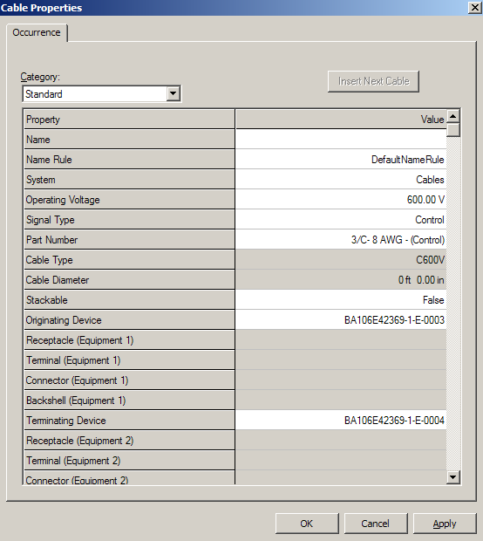
Insert Cables
  Properties
  Cable Name
  NameRule
  System
  Operating Voltage
  Signal Type
  Part Number – relationship to cable part definition ID in reference data.
  Cable Type – description corresponding to part number.
  Diameter- Cable diameter, Read-only based on Cable Part Number chosen.
© 2005. Intergraph Corporation. All Rights Reserved.

Slide 45
Insert Cables
  Properties
  Equipment 1 – Display a dialog to browse the system hierarchy to select an equipment.
  Terminal (Equipment 1) –Display a list to select a specific Terminal defined in the catalog. The terminal includes definition of the receptacle for the terminal.
  Connector (Equipment 1) – Display a list to select a connector for a given receptable defined in the catalog.
  Backshell (Equipment 1) – Display a list to select a Backshell for a given connector defined in the catalog.
© 2005. Intergraph Corporation. All Rights Reserved.

Slide 46
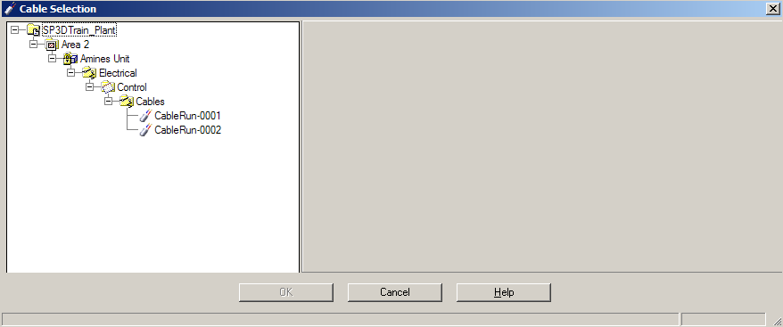
Edit Cable Path
  Cable Selection Dialog
  If there is not cable in the select set when user select the edit cable path cmd, then system display the cable selection dialog box
  List all the cables in your workspace
© 2005. Intergraph Corporation. All Rights Reserved.

Slide 47
Edit Cable Path
Exit point
  Edit Cable Path ribbon bar
  Properties page
  Select Cable(s)
  Set Entry point
  Select Cableway(s)/Conduit(s)
  Set Exit point
  Finish
  Delete path
  System
  Name
Entry point
© 2005. Intergraph Corporation. All Rights Reserved.

Slide 48
Locate the Cables
  The cable object does not have any persistent graphics of its own.
  The cable appears in the WSE under the system hierarchy.
  The graphics that show the cable route are generated from the path definition and are temporary graphics.
  When a cable is selected, a very visible, bold line will show the cable route in the select color that traces the path of the cable as defined by the cable object.
  The path is along the centerline of the cableway and conduit and straight line from the cable exit point to the equipment terminal.
© 2005. Intergraph Corporation. All Rights Reserved.

Slide 49
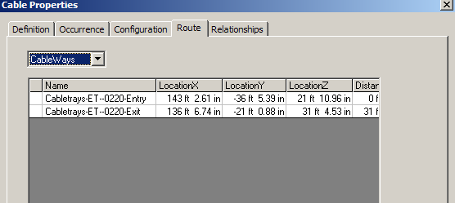
Edit Cable Path
  Cable Run Properties
  Cableways Method:
  List the cableway/.conduits junctions that the route passes through.
  All Hangers Method:
  List all hangers supporting the cableway/cabletrays that the cable passes through.
  Key Hangers Method:
  Same as All Hangers except the list only shows the hangers closest to the entry/exit and branch points.
© 2005. Intergraph Corporation. All Rights Reserved.

Slide 50
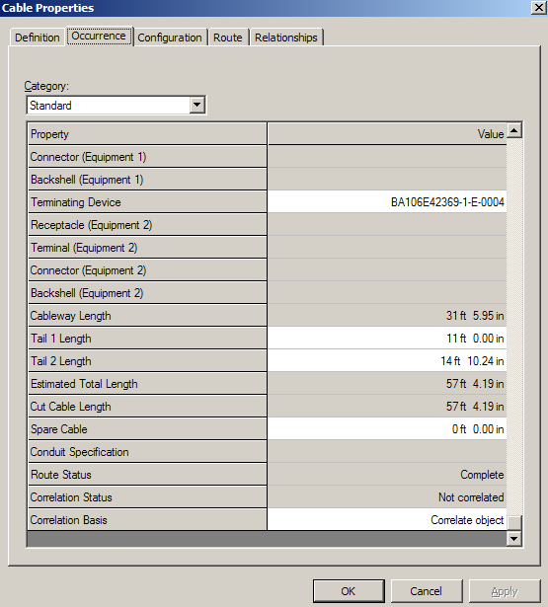
Edit Cable Path
  Properties
  Cableway Length – read only, length of cable in cableway per currently defined route inside cableways.
  Tail 1 length – editable, but defaults to orthogonal distance from point cable exits cableway to the selected terminal on equipment 1.
  Estimated Total Length – read-only. (Cableway Length + Tail 1 length + Tail 2 length).
© 2005. Intergraph Corporation. All Rights Reserved.

Slide 51
Set View by Cable Command
  The “Set View by Cable” command is provided to automatically tailor the view based on the currently selected cable. When this command is picked, a clipping volume that includes the equipment connected to the selected cable will be automatically defined in the active view. All equipment not connected to the selected cable will be automatically hidden as will other design objects in the workspace except the cableways and conduit
© 2005. Intergraph Corporation. All Rights Reserved.

Slide 52
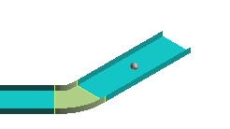
Cable Marker
  Places cable markers at points along cable tray or conduit features. You can name the markers yourself or use a naming rule. After being placed, the cable markers can be used to describe a cable path on a cable-routing report
© 2005. Intergraph Corporation. All Rights Reserved.

Slide 53
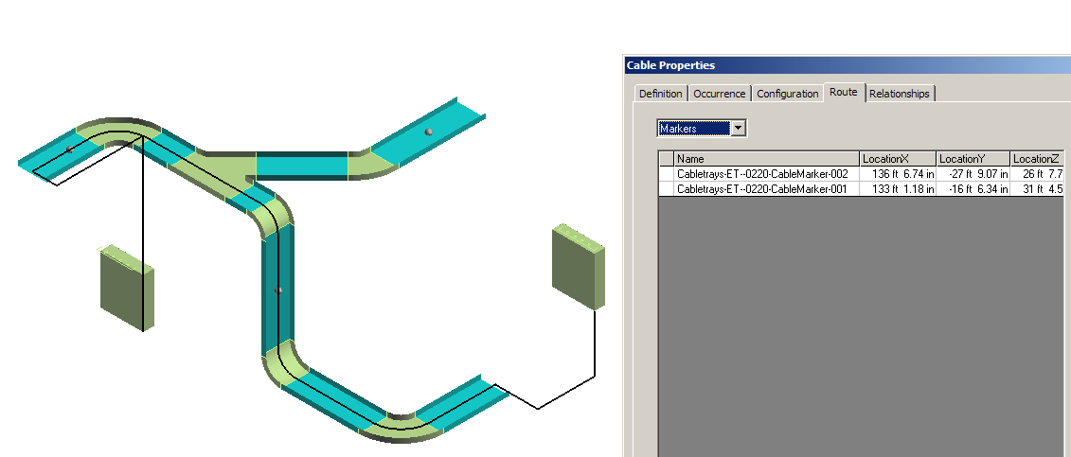
Cable Marker
© 2005. Intergraph Corporation. All Rights Reserved.

